Slide 1
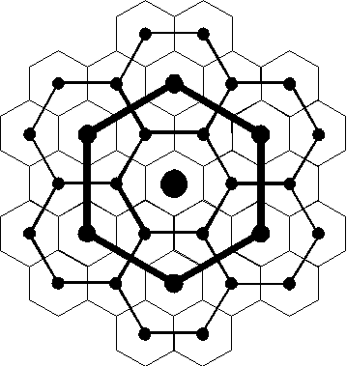
Central Place Theory
Lecture-6

Slide 2
Settlement Hierarchy
A settlement hierarchy is a way of arranging Settlements into a hierarchy based upon their population or some other criteria.
The greater the population in a settlement, the larger geographic area, the higher the status and the greater the availability of services. Position in a settlement hierarchy can also depend on the sphere of influence. This is how far people will travel to use the services in the settlement, if people travel further the town becomes more important and ranks higher in settlement hierarchy

Slide 3
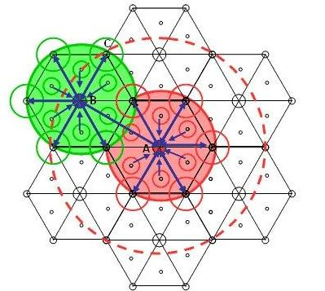
Who developed the Central Place Theory?
The Central Place Theory was developed by a German geographer, Walter Christaller
“In 1933, the book titled The Central Places in Southern Germany, Walter Christaller laid the groundwork for the central place theory.
He created this model to show how central places in the urban hierarchy would be spatially and functionally distributed?
He basically tried to calculate the nature of the central place system and recognized that some place would be central than others.

Slide 4
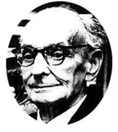
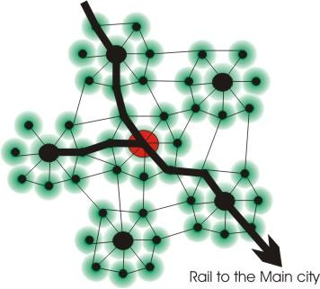
Walter Christaller
Walter Christaller was born on 1893 and died in 1969.
He was a German Geographer, whose favorite “toy” was an atlas when he was a kid… just like we did!
In 1933 he published The Central Places in Southern Germany.

Slide 5
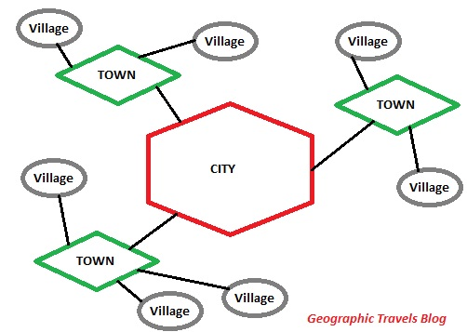

Slide 6
Christaller’s Hierarchy of Urban Settlements
General Hierarchy | Christaller’s Hierarchy |  |  |  |  | English Equivalent
 | Central Places | Towns |  | Hinterlands
 |  | Distance Apart (km) | Population (‘000s) | Size (km²) | Population (‘000s)
1st (lowest) | - | - | - | - | - | Roadside Hamlet
2nd | Marktort Amtsort | 7 12 | 0.8 1.5 | 45 135 | 2.7 8.1 | Village
3rd | Kreisstadt Bazirkstadt | 21 36 | 3.5 9 | 400 1200 | 24 75 | Sub-Town
4th | Gaustadt | 62 | 27 | 3600 | 225 | Town
5th | Provinzhaupstadt | 108 | 90 | 10800 | 675 | Major Town/City
6th | Landstadt | 186 | 300 | 32400 | 2025 | Major City
7th | Reichstadt | - | - | - | - | World City

Slide 7
C
C
C
‘Furs’
1000
City
level services
C
C
C
C
C
C
‘Furniture’
T
T
Town level services
T
T
T
T
T
T
Service Activities:
Hierarchy
Threshold and
Range
100
T
‘Food’
T
Range (square miles)
V
V
Village level services
V
V
V
V
V
10
V
V
V
Village threshold
Town threshold
City threshold
1000
10,000
100,000
Threshold population
Source: B.J.L. Berry, Geography of Market Centers and Retail Distribution (1967)

Slide 8
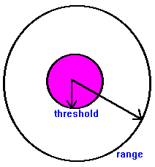
What is CPT?
Central Place Theory is a model that helps explain central places in the urban hierarchy.
The services and central market varies according to their relative size.
It consist of a Range and Threshold.
Threshold is the minimum number of people needed to support a product and Range is the distance that people are willing to travel for a product or an activity.

Slide 9
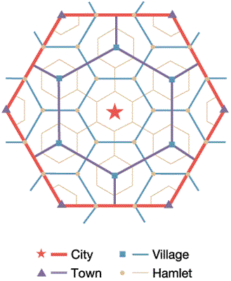
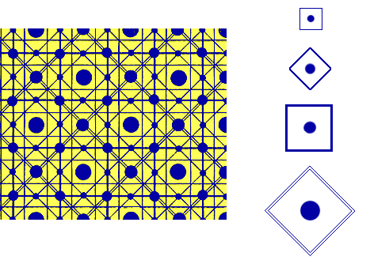
What is a Central Place?
Christaller defined Central Places as; where you get services and manufacture goods.
All urban centers must have a certain economic reach that can be used as a measure of its centrality.
The centrality of place means the relative importance of a place within its region.
The importance of a place lies not only in producing goods, but also in offering services.
The centrality of a place also refers to structural attribute of nodes in a network.

Slide 10
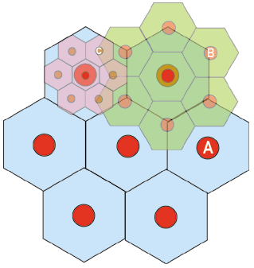
More about Central Place Theory…
He came up with three practical conclusion for his model:
He explored that the ranks of urban places form an orderly hierarchy of central places in a spatially balance way.
His model implied that places of the same size with the same number of functions would be spaced @ same distance.
His third conclusion was larger cities would be spaced farther from each other than smaller towns or villages.

Slide 11
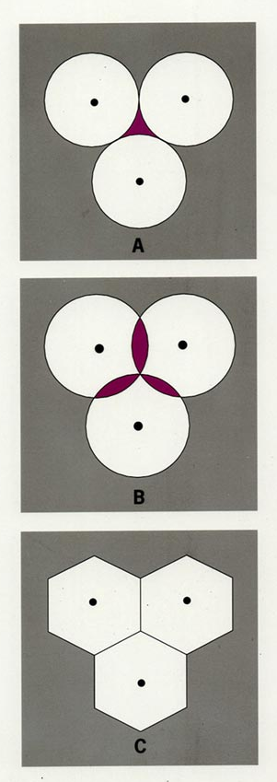


How Cristaller Conceived CPT
The shaded portion in area A
showed the un-served areas.
The red area in B indicates
places where the condition of
Monopoly would not be fulfilled.
The hexagon pattern is the best pattern
for the Central Place Theory it
completely fills the area without
overlapping each other.

Slide 12
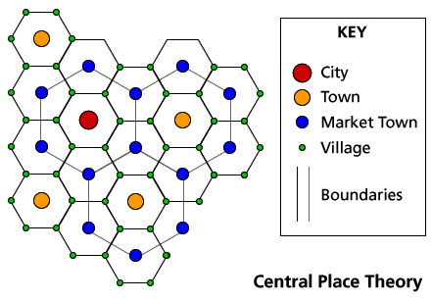
A picturesque examples
The threshold and range determines where lower and upper limits of goods and services can be found?

Slide 13



The Central Place Theory
There are three basic organizational principles that are possible in this theory:
1. Marketing must serve the maximum amount of people from a minimum number of centers. [K=3 system]
2. Transports have to be connected to a maximum number of centers and there must be minimum amount of roads. [K= 4 system]
3. Administrative goals is to provide a hierarchy of control and lower levels must be controlled by higher levels. [K=7 system]

Slide 14
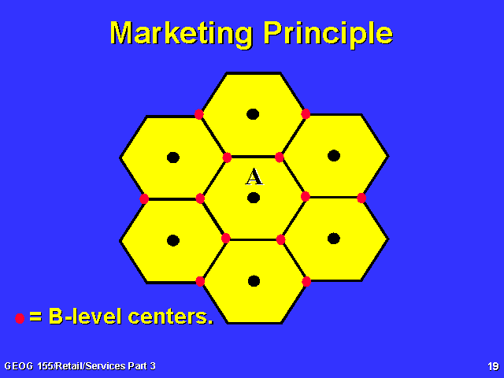
Marketing Principles
The three shapes used for this model is triangle, square, and hexagon. The hexagon settlement bests approximates a circle settlement.
The B-level area indicates 1/3 of the A-level area.
The A-level area is three times larger than the B- level area.
According to the Marketing Principle, known as the K=3 system, settlements are nested into three.

Slide 15
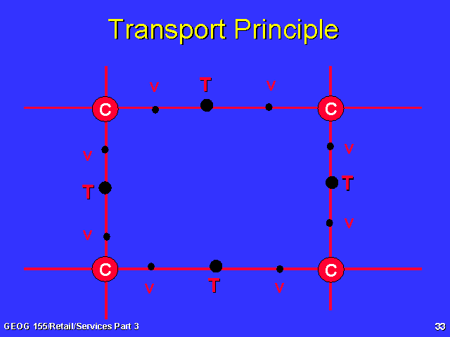
Transport Principle
The settlements are strongly influenced by the Transportation systems.
The roads are used to connect the larger settlements and smaller settlements are built along the routes.
The Total Network length is minimum and the connectivity is maximum.
According to the Transport Principle, known as the K=4 system, settlements are nested into four.

Slide 16
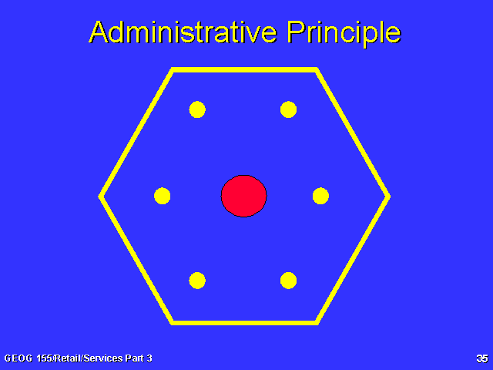
Administrative Principle
All the six lower order centers are subordinate to the Higher order centers which dominates the equivalent pattern of the market area at the next lowest area.
It’s goals is to provide a hierarchy of control, meaning the lower levels must be control by the higher level.
According to the Administrative Principle, known as the K=7 system, settlements are nested into seven.

Slide 17
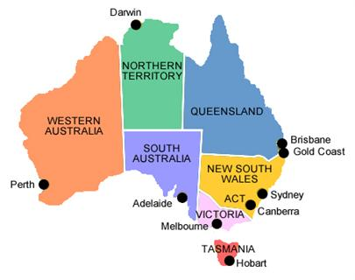

Central Place Theory in Australia
The theory states that Melbourne provides the hinterland with goods and services that are of high costs whereas low cost conditions would be supplied by local markets in the hinterland.
High cost goods would be sold in larger cities because the threshold for these goods is high enough to support a store.
Low cost products such as bread and milk is sold in small markets in a small town as central places.

Slide 18
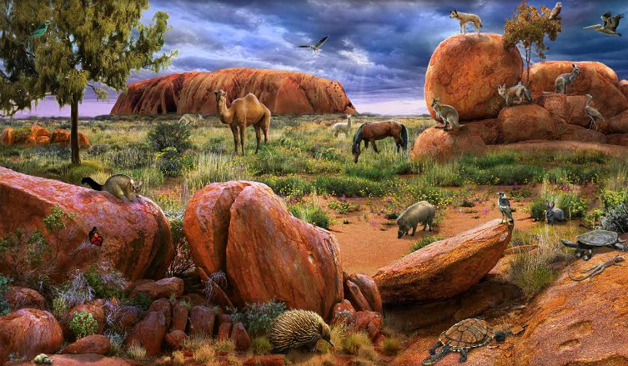
…Continue with Australia
Population distribution would decrease as you make your way out of the central city, and it would rise again if you became closer with the next central city.
The next nearest Central City would be Sydney which is over 900 kilometers from Melbourne. This cause Melbourne’s hinterland population to fall dramatically once they reaches the “Outback.”

Slide 19
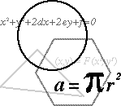
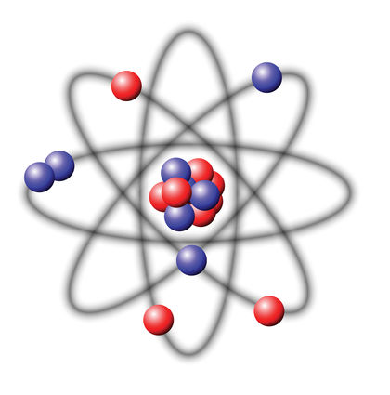
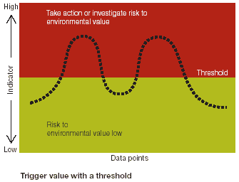
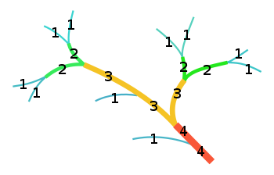
Related terms
The Sphere of influence is the area under the influence of the Central Place.
Christaller proposed that if the centralization of mass around a nucleus is an elementary form of order, then the same centralistic principle can be equated in urban settlements.
Settlements that provide low order services are called Low order settlement, and settlements that provide high order services are called High order settlements.
The minimum population size required to profitably maintain a service is the threshold population.

Slide 20
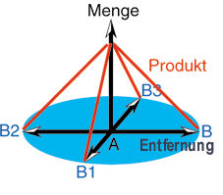

Assumptions
Primary assumptions:
The surface of the ideal region would have to be flat and have no barriers.
Soil fertility would have to be the same everywhere.
Christaller assumed an even distribution of population and purchasing power and a uniform transportation network that permitted direct travel from each settlement to the other.
He also assumed that a constant maximum distance or range of any goods or service produced in a town would prevail in all directions from that urban center.
Secondary assumptions:
Population income variation—wealthy versus the non-wealthy areas, wealthy areas do not need large threshold values
Consumer behavior and or Individual preferences.
Profit motives/variations

Slide 21
Factors affecting the fall of threshold population
Factors that affect the fall of threshold population are:
1. A decrease in population.
2. The people’s changes in tastes.
3. The introduction of substitutes.

Slide 22
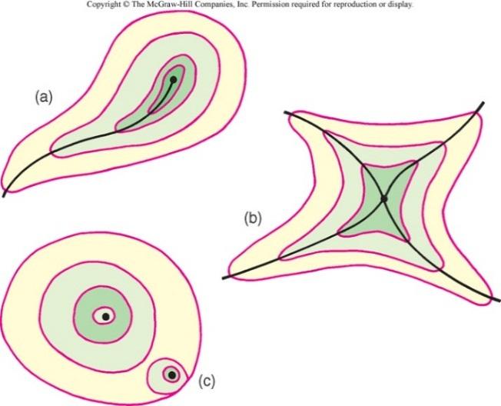
Factors shaping the extent/range of market areas
Land use: land use restriction may come in the way of a consuming population.
Poor accessibilities: this limits the extents of a center’s market areas.
Competition: they limits the extents of market areas in all direction.
Technology: high mobility afforded by the automobile allows overlapping of market areas.

Slide 23



Evaluation of CPT: a dream never materialized!
The Central Place Theory can’t be set out to real world situations because of:
The production costs may vary not only by the economies of scale but also by the natural resource endowment.
The transportation is not equal in any direction, some transportation may cost more and some may cost less.
Households, rural markets, are not evenly distributed.
Non economic factors may become more important and are not evenly distributed.

Slide 24


Continued…
Competitive practices may lead to freight absorption and phantom freight in certain region.
Large areas of flat lands are rare, with the presence of relief barriers channeling transport in certain directions.
People’s varying shopping trends not always go to the nearest center to shop.
Particular functions in the Central city changes over time.

Slide 25
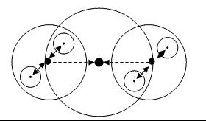
Conclusion
Christaller’s main focus was to look for a relationship within size, numbers and the geographic distribution of cities

Slide 26
Hierarchical urban Settlements System

Slide 27
























Hierarchical Urban Settlement System
Third Order City
The Lowest Order City
Second Order City
The Core City

Slide 28
Networking System of Urban Settlements
Lowest order city
Third order city
Second order city
The core city

Slide 29
Doxiadis believed that to avoid chaos we must organize our system of life from Anthropos (individual) to Ecumenopolis (global city) in hierarchical levels, represented by human settlements. So he articulated a general hierarchical scale (ELS) with fifteen levels of Ekistics Units:
  anthropos – 1 person – 3 M²
  room – 2 persons – 15 M²
  house – 5 persons – 50 M²
  house group (hamlet) – 40 persons – 0.005 Km² (0.5 hectares)
  small neighborhood (village) – 250 persons – 0.03 Km²
  neighborhood – 1,500 persons – 0.2 Km²
  small polis (town) – 10,000 persons – 1.2 Km²
  polis (city) – 75,000 persons – 7.0 Km²
  small metropolis – 500,000 persons – 40 Km²
  metropolis – 4 million persons – 300 Km²
  conurbation/small megalopolis – 25 million persons – 5000 Km²
  megalopolis – 150 million persons – 80,000 Km²
  small eperopolis – 750 million persons – 0.8 Million Km²
  eperopolis – 7,500 million persons – 6 Million Km²
  ecumenopolis – 50,000 million persons – 40 Million Km² (149 Million Km²)

Slide 30
Mandal’s Hierarchy of Urban Settlements
Level of settlement | Example | Population (1991) | Characteristics
Roadside | Hirmani | 20 | Temporary Businessmen
Hamlet | Thahi | 250 | Satellite village of Majrahia
Village | Baheri | 15,000 | Daily market
Town | Rosra | 35,000 | Sub-divisional headquarter
City | Bhagalpur | 490,000 | Divisional headquarter
Metropolis | Patna | 1,100,000 | State capital of Bihar
Conurbation | Bombay | 12,600,000 | Brick and mortar contiguity of cities
Megalopolis | North Eastern USA | 90,000,000 | Mid Atlantic sea cost in North America
Tyranopolis | Country/Continental Level | National level | Biggest urbanization continent or national level
Ecumonopolis | World urbanization | 20,000,000,000 | World urban community
Nekropolis | Ghost City | Hiroshima (1945) Basra (1991) | May develops in any stage of urban growth

Slide 31
Christaller’s Hierarchy of Urban Settlements
General Hierarchy | Christaller’s Hierarchy |  |  |  |  | English Equivalent
 | Central Places | Towns |  | Hinterlands
 |  | Distance Apart (km) | Population (‘000s) | Size (km²) | Population (‘000s)
1st (lowest) | - | - | - | - | - | Roadside Hamlet
2nd | Marktort Amtsort | 7 12 | 0.8 1.5 | 45 135 | 2.7 8.1 | Village
3rd | Kreisstadt Bazirkstadt | 21 36 | 3.5 9 | 400 1200 | 24 75 | Sub-Town
4th | Gaustadt | 62 | 27 | 3600 | 225 | Town
5th | Provinzhaupstadt | 108 | 90 | 10800 | 675 | Major Town/City
6th | Landstadt | 186 | 300 | 32400 | 2025 | Major City
7th | Reichstadt | - | - | - | - | World City

Slide 32
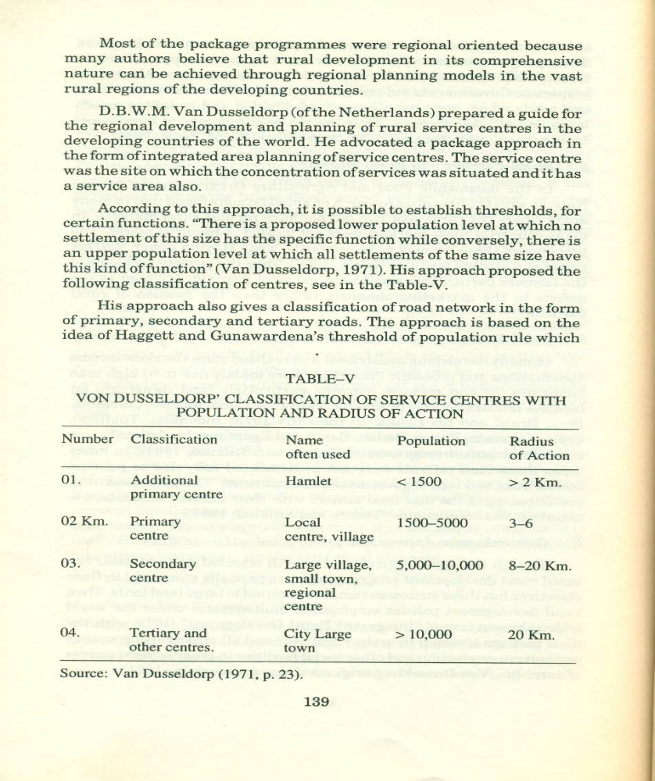
Van Dusseldorf's Hierarchy of Service Centers

Slide 33
Aurousseau’s Functional Classification of Towns
Classes | Functions | Examples
Class-I | Administration | Capital cities, Revenue towns
Class-II | Defense | Fortress town, Garrison towns, naval bases
Class-III | Culture | University towns, Cathedral towns, Arts centers, Pilgrimage centers, Religious centers
Class-IV | Production | Industrial towns
Class-V (Communication) | a) Collection | Mining towns, Fishing towns, Forest towns, Depot towns
 | b) Transfer | Market towns, Fall line towns, Break-o-Bulk towns, Bridgehead towns, Tidal limit towns, Navigation head towns
 | c) Distribution | Export towns, Import towns, Supply towns
Class-VI | Recreation | Health resorts, Tourist resorts, Holiday resorts

Slide 34
Rosir’s Functional Classification of Towns
Classes | Functions | Examples
Class-I | Cities of Consumption | Residential or Resort places
Class-II | Cities of Production | Mainly Manufacturing
Class-III | Mixed Activity Cities | Consumption and Production
Class-IV | Cities of Storage and Distribution | Wholesale
Class-V | River and Seaport Cities | Lahore, Karachi, Bombay, Amsterdam
Class-VI | Receiving and Forwarding Cities | Free Ports where goods are transferred
Class-VII | Cities of Finance and Credit | London, New York, Tokyo, Frankfurt
Class-VIII | Cities of Working Men and Artisans | Chiniot, Hyderabad
Class-IX | Military Cities | Malta, Belfast, Kiel
Class-X | Thermal or Bath Cities | Rajgir, Allahabad
Class-XI | Climatic Cities | Nice, Annecy, San Remo
Class-XII | Museum Cities | Hyderabad
Class-XIII | University Cities | Oxford

